Slide 1
Capstone Project - 2
Supervised machine learning(regression)- Appliance Energy Prediction
Mohammad zabi ur rahamn
Komal
Mohd abdul samad

Slide 2
All about this presentation:
Defining problem statement.
Overview of data.
Performing exploratory data analysis.
Model preparation.
Building different models.
Evaluation of all models.
Extracting the best model.

Slide 3
Problem statement
We are tasked with predicting the amount of energy consumed in watt per hour(wh) by tracking the usage of appliances in the household from the data collected throughout 4.5 months at every 10 minute interval to understand the trend and growth of energy consumption of residential buildings in Belgium.

Slide 4
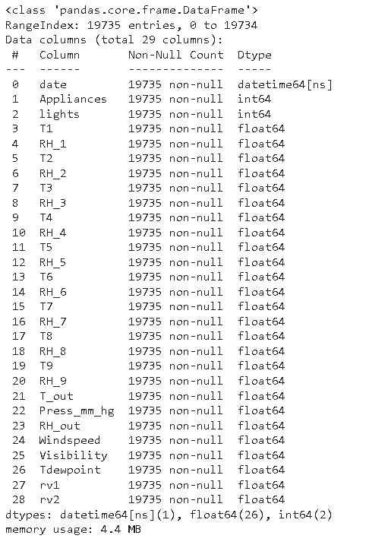
Overview of given data
Date: Date and time of the Appliances usage recorded
Appliances: Values of appliance usage in Watt per hour(Wh)
Lights : Energy use of light fixtures in the house in Wh
T1 : Temperature in kitchen area, in Celsius
RH1, : Humidity in kitchen area, in %
T2: Temperature in living room area, in Celsius
RH2,Humidity in living room area, in %
T3, Temperature in laundry room area
RH3, Humidity in laundry room area, in %
T4, Temperature in office room, in Celsius
RH4,Humidity in office room, in %
T5, Temperature in bathroom, in Celsius
RH5, Humidity in bathroom, in %
T6, Temperature outside the building (north side), in Celsius
RH6, Humidity outside the building (north side), in %
T7, Temperature in ironing room , in Celsius
RH7, Humidity in ironing room, in %
T8, Temperature in teenager room 2, in Celsius
RH8,Humidity in teenager room 2, in %
T9, Temperature in parents room, in Celsius
RH9, Humidity in parents room, in %
To, Temperature outside (from Chievres weather station), in Celsius
Pressure (from Chievres weather station), in mm Hg
RHout, Humidity outside (from Chievres weather station), in %
Wind speed (from Chievres weather station), in m/s
Visibility (from Chievres weather station), in km
Tdewpoint (from Chievres weather station), Â°C
rv1, Random variable 1, nondimensional
rv2, Random variable 2, nondimensional

Slide 5
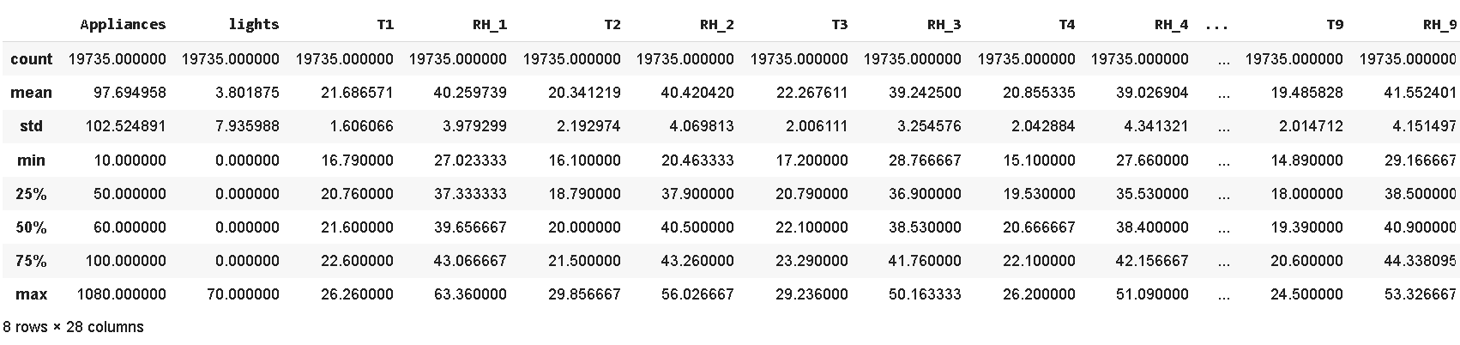
Description of data

Slide 6
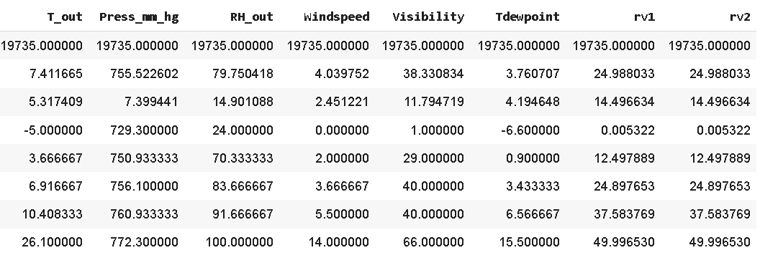
Description of data(contd)

Slide 7
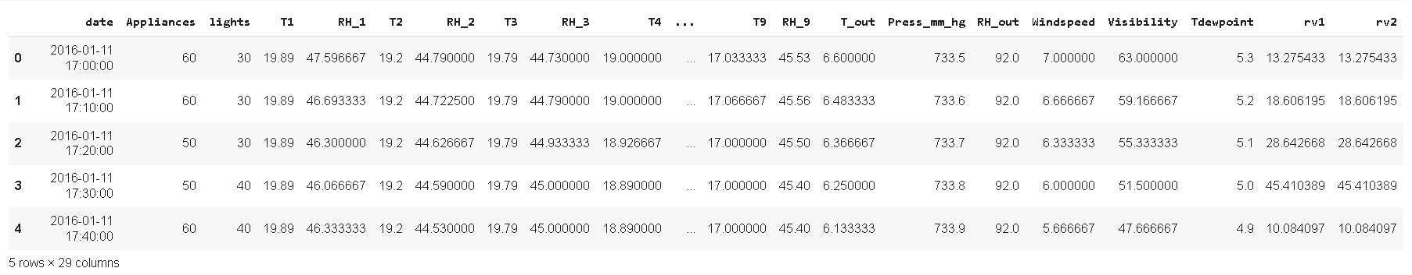
Sample of data

Slide 8
Exploratory data analysis
Exploratory Data Analysis refers to the critical process of performing initial investigations on data so as to discover patterns,to spot anomalies,to test hypothesis and to check assumptions with the help of summary statistics and graphical representations.
EDA is for seeing what the data can tell us beyond the formal modeling
or hypothesis testing task.

Slide 9
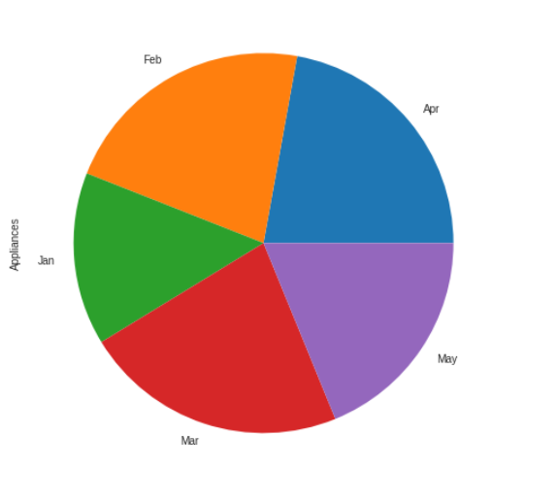
Comparison of Appliances used Seasonally
conclusions from above pie chart:
In Feb, Mar, April, the usage of appliances is more or less equal.
Least appliance usage was recorded in Jan.

Slide 10
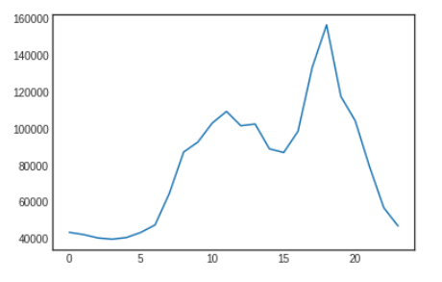
Comparison of Hourly Appliance Usage
This plot is the sum of all of the energy values across Jan to May for an hour. The usage of appliances is a steady rise starting from 12 am and hits peak aroud 18th hour of the day. Then, after hitting its peak it takes a sudden dip starting from 21st hour.

Slide 11
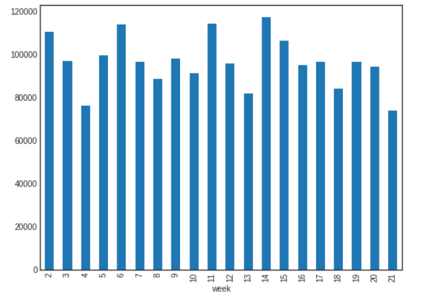
Comparison of Appliance Usage (all weeks)
At week 14 i.e, the second week of April, the usage of appliances is the highest and on the other hand, its lowest in the last week of the period i.e, the fourth week of May.

Slide 12
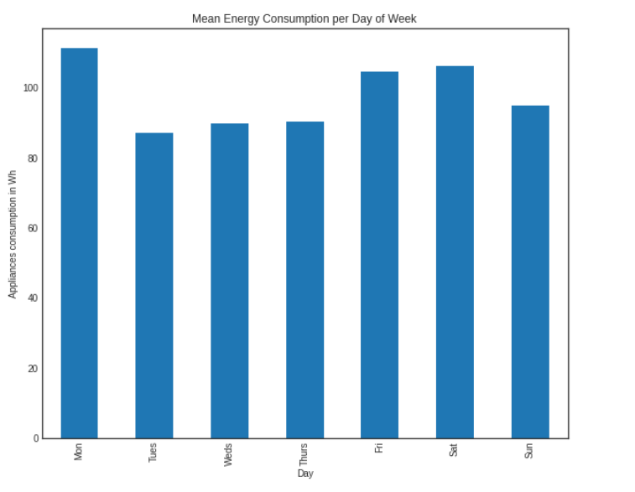
Comparison of Appliance Usage (type of week)
Energy Usage was obeserved to be at its peak on Monday and it was it's listed on Tuesday.

Slide 13
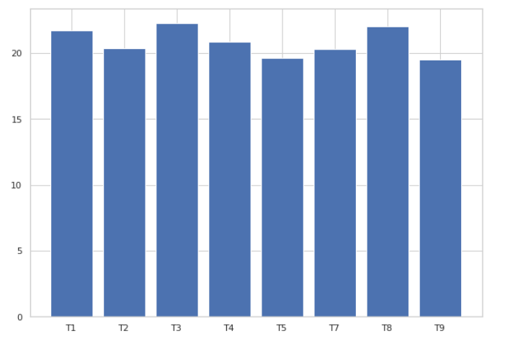
Comparison of variations of temperatures among all the rooms of the building
The warmest temperatures are laundry room(T3), teenager room(T8) and kitchen area(T1) respectively. And the coldest rooms are bathroom(T5) and parents room(T9).

Slide 14
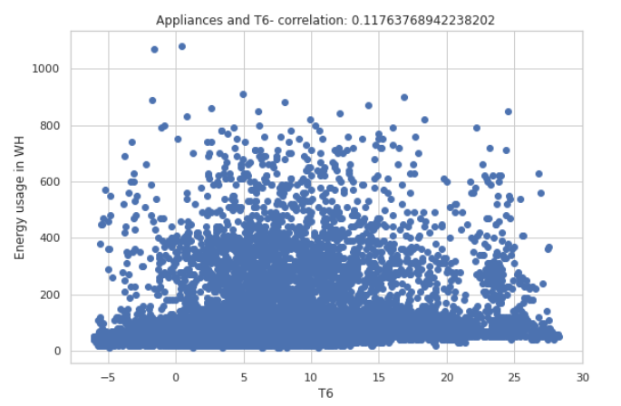
Comparison energy variations with respect to temperatures outside the bulding
The correlation is minute but it exists between energy use and temperature northside of the building. The energy usage stays consistent from temperatures 5° to 25°. At extreme high and low temperatures, the energy usage is relatively low

Slide 15
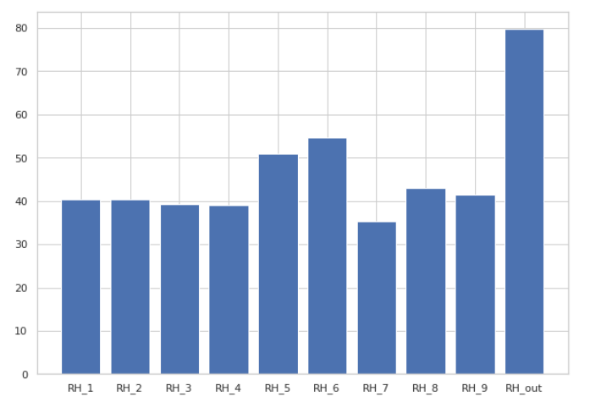
Distribution Energy variation with respect to humidity in different rooms of building.
The humidity is at its highest outside the building(RH_out) and lowest in the ironing room(RH_7)

Slide 16
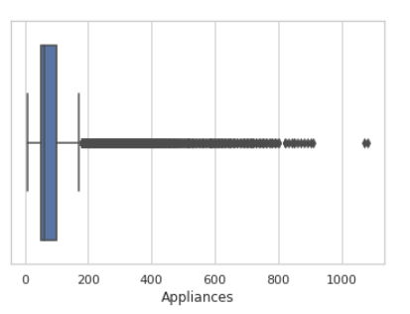
Treating outliers for Appliances column using Box Plot
The number of the 0.1% top values of appliances' load is 19 and they have power load higher than 140 Wh as outliers.

Slide 17
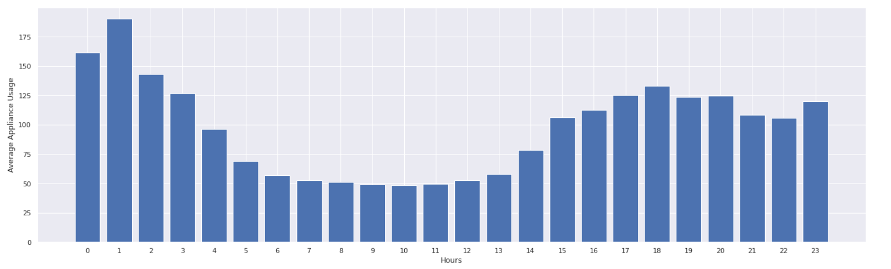
Distribution of average use of Appliances
This plot is the average of energy usage values across Jan to May. The energy usage was at its peak during 1st hour and it was as its least during 9th and 10th hour of the day.

Slide 18
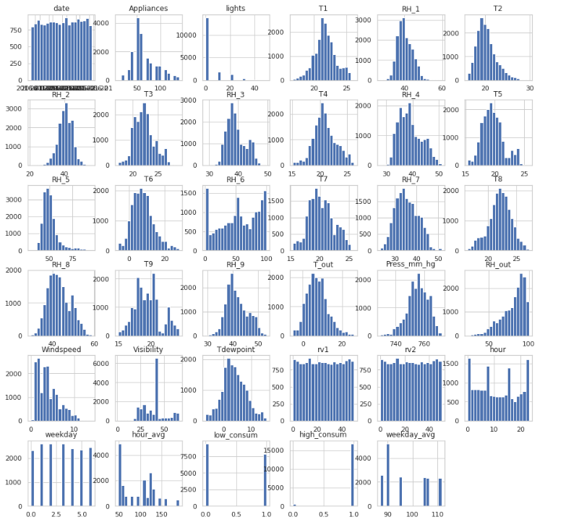
Distribution of all dataset column values

Slide 19
Model preparation
Calculating multicollinearity through VIF and filtering our data.
Plotting the correlation heatmap of all the columns to visualize the collinearity after dropping columns using VIF.
All of the values are of desired data type of modelling i.e, Int64 and Float64
There aren’t any null values across the dataset.

Slide 20
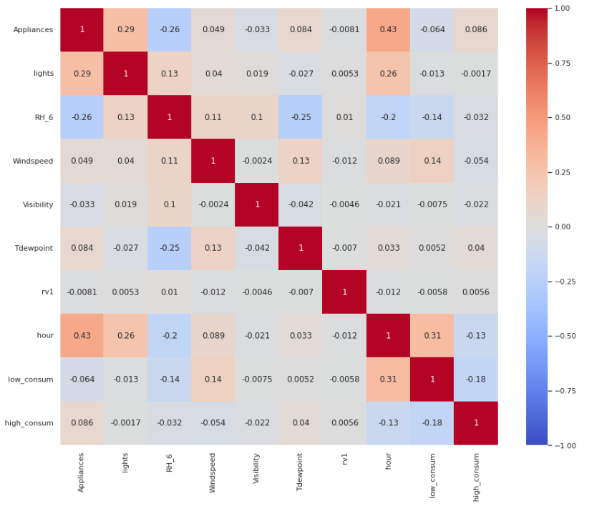
Correlation Heat Map
This heatmap is plotted after dropping columns which had high VIF scores.

Slide 21
Models used
Linear regression model
Lasso regression model
Ridge regression model
Decision tree regression model
Random-forest regression model
Extra-trees regression model
XGBoost regression model

Slide 22
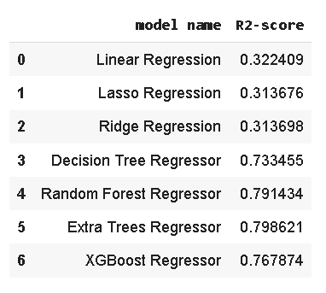
Evaluation of models
From above it is clear that extra-trees regression model has done very well with our dataset with an R2- score of ~80% accuracy

Slide 23
Challenges faced
Pre-processing the data was one of the challenges we faced which includes removing highly correlated variables from the data so as to not hinder the performance of our regression model.
Exploring all the columns and calculating VIF for multicollinearity was challenging because it might decrease the models performance.
Selecting the appropriate models to maximize the accuracy of our predictions was one of the challenges faced.

Slide 24
Conclusion
We are finally at the conclusion of our project!
Coming from the beginning we did EDA on the dataset and also cleaned the data according to our needs.After that we were able to draw relevant conclusions from the given data and then we trained our model on linear regression and other models .
Out of all models used , with extra-trees regression model we were able to get the r2- score of 0.85.The model which performed poorly was Lasso regularization with r2- score of 0.31.
Given the size of data and the amount of irrelevance in the data , the above score is
good.

